Slide 1

Ruby Concurrency Jerry D’Antonio @jerrydantonio
Notes:
# Ruby Concurrency
Hello, my name is Jerry D'Antonio. I work for VHT (formerly Virtual Hold Technology),
an Erlang and Ruby shop in Akron, Ohio. Today I'm here to talk to you about concurrency.
## Slide 1: Introduction
### Asynchronous
The word of the day is "Asynchronous"
* Old-school concurrency is "lock and synchronize"--synchronize threads by locking shared resources
* With asynchronous concurrency we *coordinate* independent operations without locking
* There are many patterns for performing asynchronous concurrency
### What We'll Cover
Today is about ideas, concepts, and abstractions. All modern programming languages tell their own concurrency story. Ask a Clojure programmer about concurrency and you’ll hear about agents and futures. Ask a Scala programmer about concurrency and you’ll hear about actors. Ask an Erlang programmer about concurrency and you’ll hear about gen_server and supervisor. Ask a Ruby programmer about concurrency and you’ll hear about… threads and mutexes.
To paraphrase something I heard on Twitter recently, Ruby needs a better concurrency story.
Concurrency is *not* about threads. Threads are simply a tool. Concurrency is about algorithms. Sometimes those algorithms are concerned with performances. Other times those algorithms are about simplicity. Remember when you first learned about recursion? Remember how amazing it was to discover that some algorithms were much simpler and cleaner when written recursively? The same is true with concurrency. Some algorithms are simple more elegant when expressed concurrently—even on a single core, single processor system. Performance of the underlying concurrency primitives (such as threads) will always be part of the discussion, much the way performance is always a part of a recursion discussion. But you need to understand the high-level ideas before you can talk about the low-level details.
Today we will look at numerous asynchronous concurrency abstractions
* Each is available in one or more programming languages other than Ruby--either as a widely-followed specification, in the standard library, or in the language itself
* We will look at a *ton* of source code
* All the source code is available in a GitHub repo along with the slides and the notes
* Most of the code we will look at will use the Concurrent Ruby gem
* An MIT licensed open source gem that I created
* We use it at VHT
* Intended to be a "utility belt" with a bunch of useful concurrency tools
* Simple-yet-powerful tools, loosely coupled, each with a single purpose
* Each is based on a concurrency tool available in another language
* It has no dependencies outside of the Ruby standard library
* It does not use Fibers so behaves consistently across interpreters
* It has no known incompatibilities with any major gems
* It should be usable in any program you want to use it in--programs that already exist and that you have yet to write
* It is available on GitHub (https://github.com/jdantonio/concurrent-ruby)
* And Rubygems (https://rubygems.org/gems/concurrent-ruby)
* We don't have time to go over all the code line-by-line so I ask that you focus on the *concepts* and examine the code in detail later

Slide 2

Notes:
## Slide 2: Crash Test Dummy
Before we start looking at the code, we need a crash test dummy.
* Often when showing sample concurrent code we use `sleep` statements to simulate non-determinism
* This works, but is something of a cop-out
* For this presentation I have created a small class for test driving our sample code

Slide 3
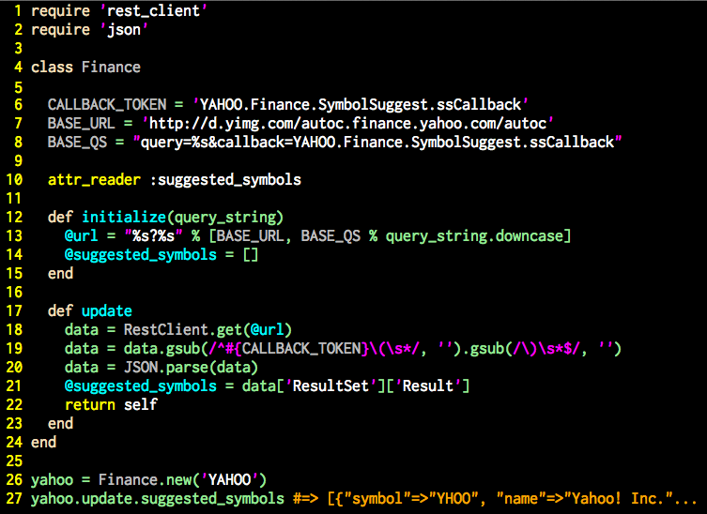
Notes:
## Slide 3: Finance class
This class will serve as our crash test dummy. We will use this class in almost all of our sample code. It isn't a very well-designed class but it exhibits several characteristics which are important when writing concurrent code.
### What does it do?
This class:
* Takes the name of a company (say, "Yahoo") in the constructor
* Uses the `#update` method to query a Yahoo API and retrieve a list of stock ticker symbols for that company on all known international stock exchanges
* It parses the returned data, removing the AJAX wrapper and converting what remains into an array of hashes
* It then stores the data in an instance variable
### Characteristics of the code
* Performs blocking I/O--one of the main reasons for concurrency
* It performs a computationally-intensive tasks--requires true *parallelism* for improved performance
* Is a *mutable* object (shared mutable data is bad)
* Exposes a reference to a mutable data structure via an attribute reader (again, shared mutable data is bad)

Slide 4

Notes:
## Slide 4: Back to the Future
The first abstraction we are going to look at is the *future*.
* http://clojuredocs.org/clojure_core/clojure.core/future
* One of the core concurrency abstractions in Clojure
* Represents the *result* of a computation that will be performed at some future time
* On creation the task is scheduled for execution by the runtime
* The main thread can then do other stuff and retrieve the result of the operation later

Slide 5
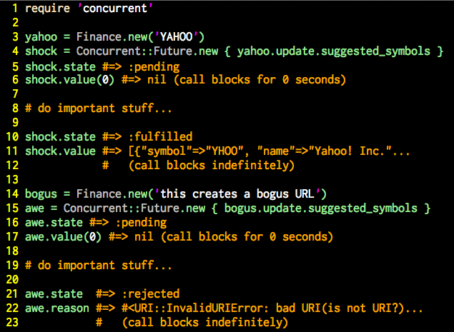
Notes:
## Slide 5: Simple Future code sample
The first code example shows a successful operation:
* Creates a new `Finance` object and send it to the future
* The state of the future is `:pending`
* The value of the future is 'nil`
* The main thread then does important stuff with the operation completes
* On success the state of the object becomes `:fulfilled` and the value of the future becomes the result of the operation
* From this point forward the future is *immutable*
* A future does one thing and then is done forever
The second example is similar to the first but shows the failure case:
* The operation raises an *exception*
* An exception thrown from the operation is the only way to signal failure
* The state of the future becomes `:rejected`
* The exception that was raised is now accessible through the `#reason` accessor

Slide 6
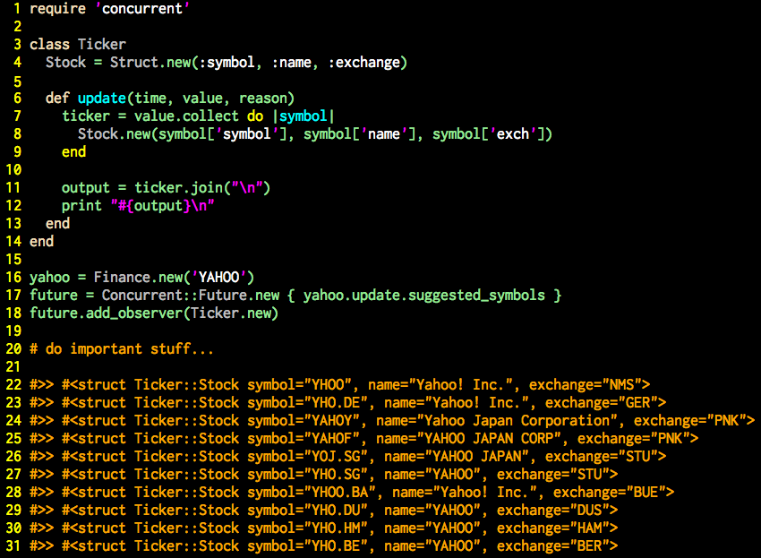
Notes:
## Slide 6: Future with a callback
There are two ways to act upon the result of an asynchronous operation:
* Query the asynchronous for the result (occurs on a different thread than the operation)
* Provide a *callback* operation to run when the operation is complete
* The callback usually happens on the same thread as the asynchronous operation
* The term *errorback* is occasionally used when a callback is only run in response to an error
### Observable
* The Ruby standard library provides a very good callback mechanism via the `Observable` module
* http://ruby-doc.org/stdlib-2.0/libdoc/observer/rdoc/Observable.html
* This implementation of future supports Ruby's `Observable`
* This code example creates an observer class
* The `#update` method receives a `Time` object (representing the completion time of the future) and the final values of the `value` and `reason` attributes (one of which will always be `nil`)
* The `#add_observer` method of the `Future` class is concurrency-aware and will behave correctly in the off-chance the future completes *before* the `#add_observer` method is called

Slide 7

Notes:
## Slide 7: Secret Agent Man
The next abstraction we will look at is the agent
* http://clojuredocs.org/clojure_core/clojure.core/agent
* Another of the core concurrency abstractions in Clojure
* Represents an atomic value that changes over time
* Rather than placing a lock around a variable and letting threads compete for access, we hide the variable and let threads send *operations* against the variable
* The agent queues the operations and performs them in the order received
* The value of an agent is the value at that exact moment in time, irrespective of an in-progress operation and any queued operations
* A good example is the score in a video game

Slide 8
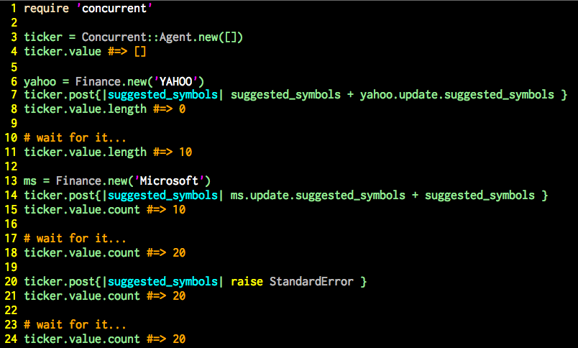
Notes:
## Slide 8: Agent code sample
* A new agent is created and given an initial value at construction (in this case an empty array)
* Several modification operations are then sent to the agent
* Each operation receives the current value of the agent and returns the new value
* The important thing to note is that operations on an agent need no *a priori* knowledge of the agent's value--it gets the current value when the operation is run
* Although not shown on this slide, this implementation of agent supports the `Observable` module, validation of the result of each operation, and exception handling callbacks (errorback)
* It also provides options for how to handle the return value when the `#value` method is called
### Possible Bug
This code does one *very* bad thing:
* There is a very serious source of potential bugs in this code
* The bug occurs every time we call the `#value` method
* This bad practice leads us directly to our next topic…

Slide 9

Notes:
## Slide 9: Mutation
Shard mutable variables are *bad*
* When discussing concurrent programming one common mantra is "avoid shared mutable data"
* This true--when possible *avoid shared mutable data*
* This isn't always possible--sometimes data must be shared across threads
* Many functional programming languages (Erlang, Clojure, Haskell, F#) get around this by having *immutable* variables
* Not in Ruby--all our variables are *references to mutable objects*
* In the previous slide we passed such a reference out of our agent every time we called the `#value` method
* *Any* thread with a reference to the array can change the value
* Plus, access to the array is not thread safe (no locking)
* This is *very, very bad*

Slide 10

Notes:
## Slide 10: Enter the Hamster
* Ideal hash trees are an extremely efficient data structure that can be used, among other things, to create immutable data structures that are still extremely high-performance
* Ideal hash trees are the underlying tech in Clojure's immutable data structures
* The Hamster gem is an excellent Ruby library providing thread safe immutable data structures based on ideal hash trees
* http://infoscience.epfl.ch/record/64394
* http://infoscience.epfl.ch/record/64394/files/triesearches.pdf
* http://lampwww.epfl.ch/papers/idealhashtrees.pdf

Slide 11
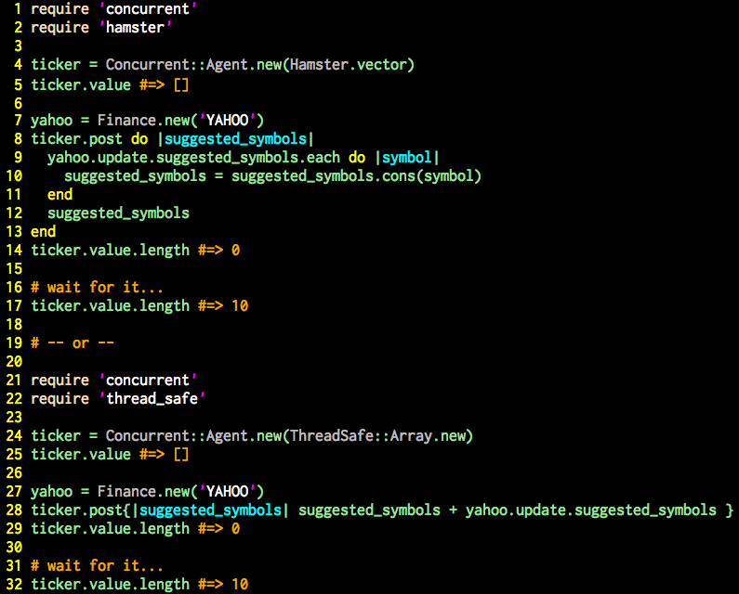
Notes:
## Slide 11: Hamster and thread_safe
### Hamster
https://github.com/harukizaemon/hamster
* The first example uses a Hamster vector instead of an array
* Because the vector is immutable we need to copy it on every operation rather than modify it in-place
* Because of the internal ideal hash tree implementation this is an incredibly fast operation
* Our agent is now thread safe *and* calls to `#value` returns and immutable vector
* Of course, that hashes in the vector are still mutable...
### thread_safe
https://github.com/headius/thread_safe
* thread_safe is an excellent library providing thread-safe implementation of Ruby's Array and Hash classes
* Built be a member of the JRuby core team (but supports MRI and Rbx, too)
* Access to the internal array in this example is thread-safe, but we still provide a mutable reference
### Remember...
*Thread-safety and immutability are not the same thing*
*Always be aware of what you are passing across threads and protect your data accordingly*
Note: This agent implementation provides a couple of constructor arguments that can help--see the README

Slide 12

Notes:
## Slide 12: Promises, Promises
A `Promise` is a variation of the Future abstraction we saw earlier. It's the most prominent asynchronous
concurrency abstraction in JavaScript. jQuery calls them *defers*.
* http://wiki.commonjs.org/wiki/Promises/A
* http://promises-aplus.github.io/promises-spec/
* Colloquially, "future" (with a lowercase "f") is any asynchronous abstraction that represents an operation that will occur at some nondeterministic time in the future
* The Future class we saw early is just one possible variation
* "Promise" and "Defer" are also names for futures
* Different libraries implement them differently, or implement them the same but call them different things
* It is common to hear/read the phrase "method X returns a future"
* The Concurrent Ruby library uses the `Obligation` mixin to define the "future" API

Slide 13
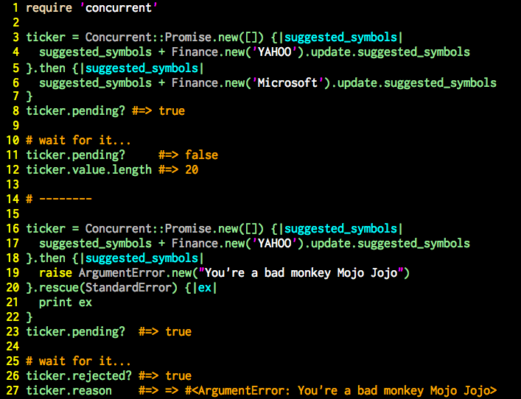
Notes:
## Slide 13: Simple Promise code sample
* Popular in JavaScript (called *defer* in jQuery)
* Similar to the future we saw earlier but chainable
* A promise begets a promise which begets a promise…
* There are strict rules for the ordering of operations in promise chains, specifically regarding failure/rejection
* This implementation is also very true to the Promises/A and Promises/A+ specifications
* This implementation does *not* support `Observable`--it uses the built-in callback mechanism instead

Slide 14

Notes:
## Slide 14: Ticking time bomb
* We've all used `cron` and it's awesome. But sometimes we want `cron`-like functionality within our code
* For one-time scheduling of an event we can use `ScheduledTask`
* This implementation is loosely based on Java's `ScheduledExecutorService`
* http://docs.oracle.com/javase/7/docs/api/java/util/concurrent/ScheduledExecutorService.html

Slide 15
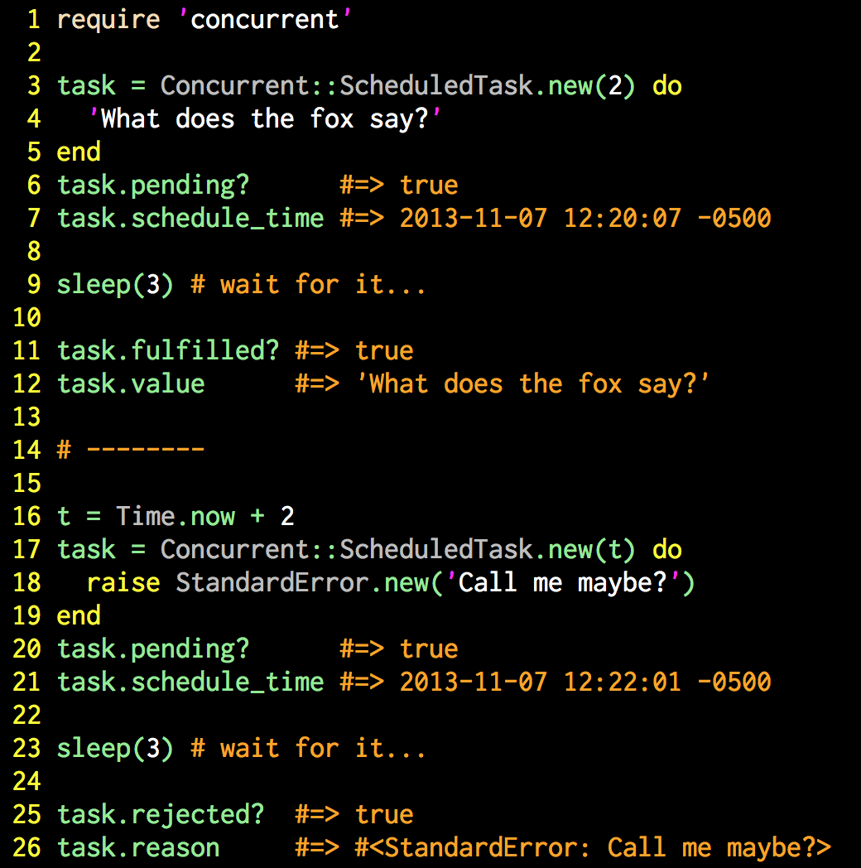
Notes:
## Slide 15: ScheduledTask
* `ScheduledTask` looks and acts much like `Future` except that execution is delayed
* Execution time is defined at object creation
* A number of seconds from now
* Or a specific `Time`
* The resulting object is a "future" in the context we previously discussed
* And this implementation supports the same `Obligation` API of `Future` and `Promise`

Slide 16
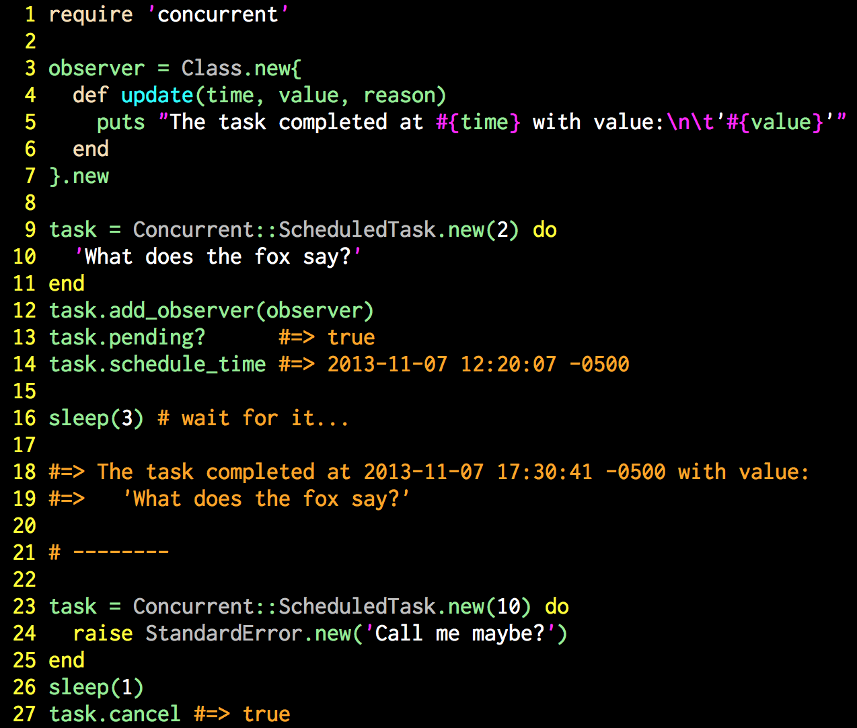
Notes:
## Slide 16: More fun with ScheduledTask
* This implementation of `ScheduledTask` mixes in Ruby's `Observable` module
* And a `:pending` task can also be cancelled with the `#cancel` method

Slide 17

Notes:
## Slide 17: And so on and so on and so on...
* The other `cron`-ish goodness we sometimes want to implement in code is a repetitive task that happens over and over and over again at regular intervals.
* For this we use the `TimerTask` class.
* This implementation is loosely based on the Java class of the same name
* http://docs.oracle.com/javase/7/docs/api/java/util/TimerTask.html)

Slide 18
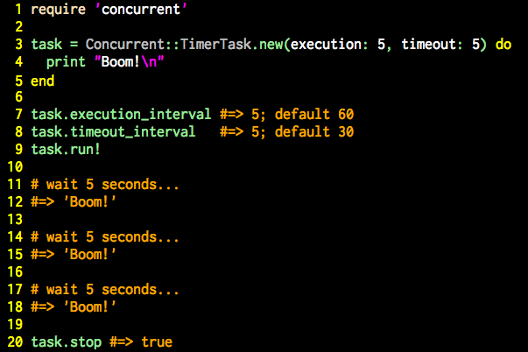
Notes:
## Slide 18: Simple TimerTask
* Want to perform an operation at regular intervals (every 10 seconds, every 5 minutes, etc.)
* Can be stopped and restarted at will

Slide 19
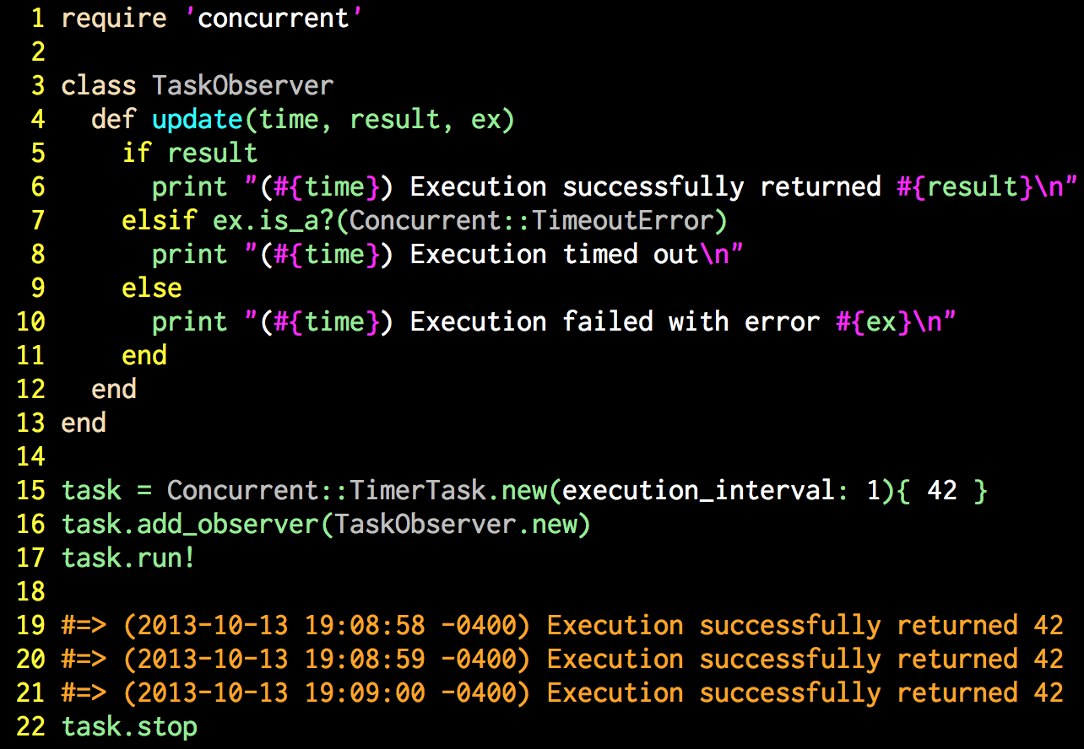
Notes:
## Slide 19: TimerTask with observation
* The `TimerTask` class includes the `Observable` mixin module

Slide 20
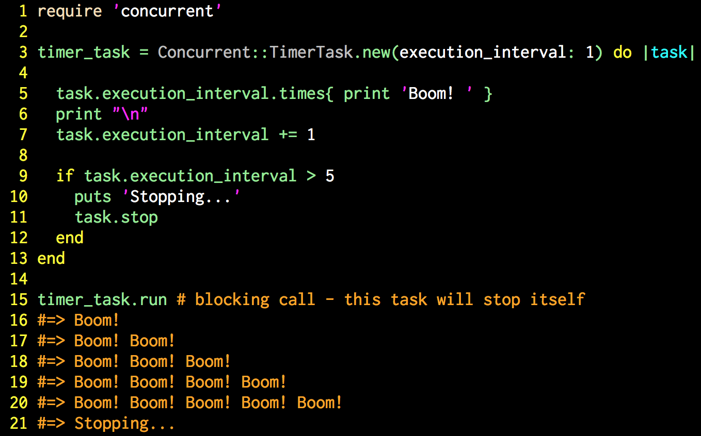
Notes:
## Slide 20: TimerTask that changes its own execution
* In rare cases a `TimerTask` may want to update its own execution lifecycle
* On execution a reference to the task object will be passed as the first block parameter
* The task can then alter its own lifecycle, even shutting itself down

Slide 21

Notes:
## Slide 21: All the world's a stage
The actor model is becoming very popular lately, largely due to interest in Erlang. Actors are also surprisingly controversial in some circles.
* The actor model was first proposed in 1973 by Originally proposed in 1973 by Carl Hewitt, Peter Bishop, and Richard Steiger at the M.I.T. Artificial Intelligence Laboratory
* Much has changed since 1973
* There is not universally accepted strict definition of what an actor is
* Most would agree on the general idea but arguments over the details abound
* Actor implementations vary widely--no two are the same
### What is an actor?
My definition:
An independent, concurrent, single-purpose, computational entity that communicates exclusively via message passing.

Slide 22
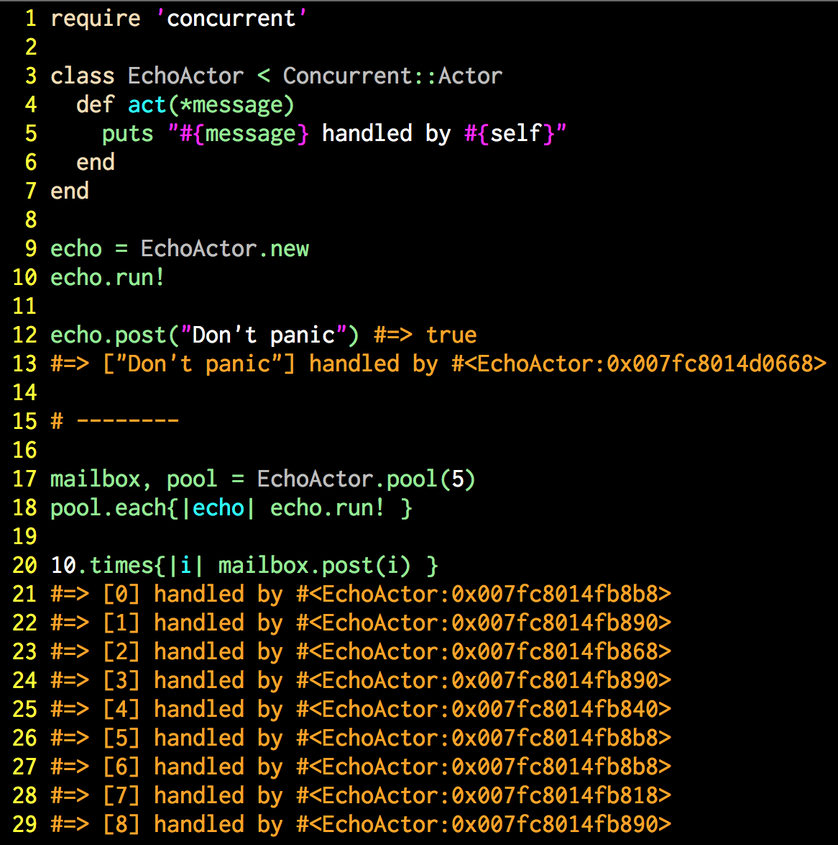
Notes:
## Slide 22: Actor and an Actor pool
* The Actor class in this library is based solely on the Actor task defined in the Scala standard library.
* http://www.scala-lang.org/api/current/index.html#scala.actors.Actor
* It does not implement all the features of Scala's Actor
* But its behavior for what *has* been implemented is nearly identical
* The excluded features mostly deal with Scala's message semantics, strong typing,
and other characteristics of Scala that don't really apply to Ruby.
* Unlike most of the abstractions in this library, `Actor` takes an *object-oriented*
approach to asynchronous concurrency, rather than a *functional programming* approach
* Actors are defined by subclassing the `Concurrent::Actor` class and overriding the `#act` method
* Actors can also be pooled--a collection of actors share the same mailbox

Slide 23
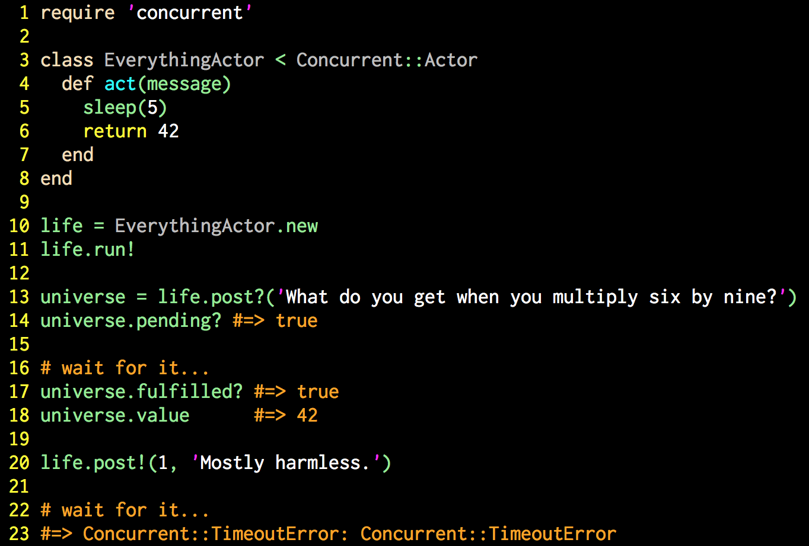
Notes:
## Slide 23: Different ways to post
* There are several variations of the `#post` method available
* The `#post?` method returns a "future" object that can be queried for the result
* The `post!` method blocks and waits for the result
* `Concurrent::Runnable::LifecycleError` will be raised if the message cannot be
queued, such as when the `Actor` is not running.
* `Concurrent::TimeoutError` will be raised if the message is not processed within
the designated timeout period
* Any exception raised during message processing will be re-raised after all
post-processing operations (such as observer callbacks) have completed

Slide 24
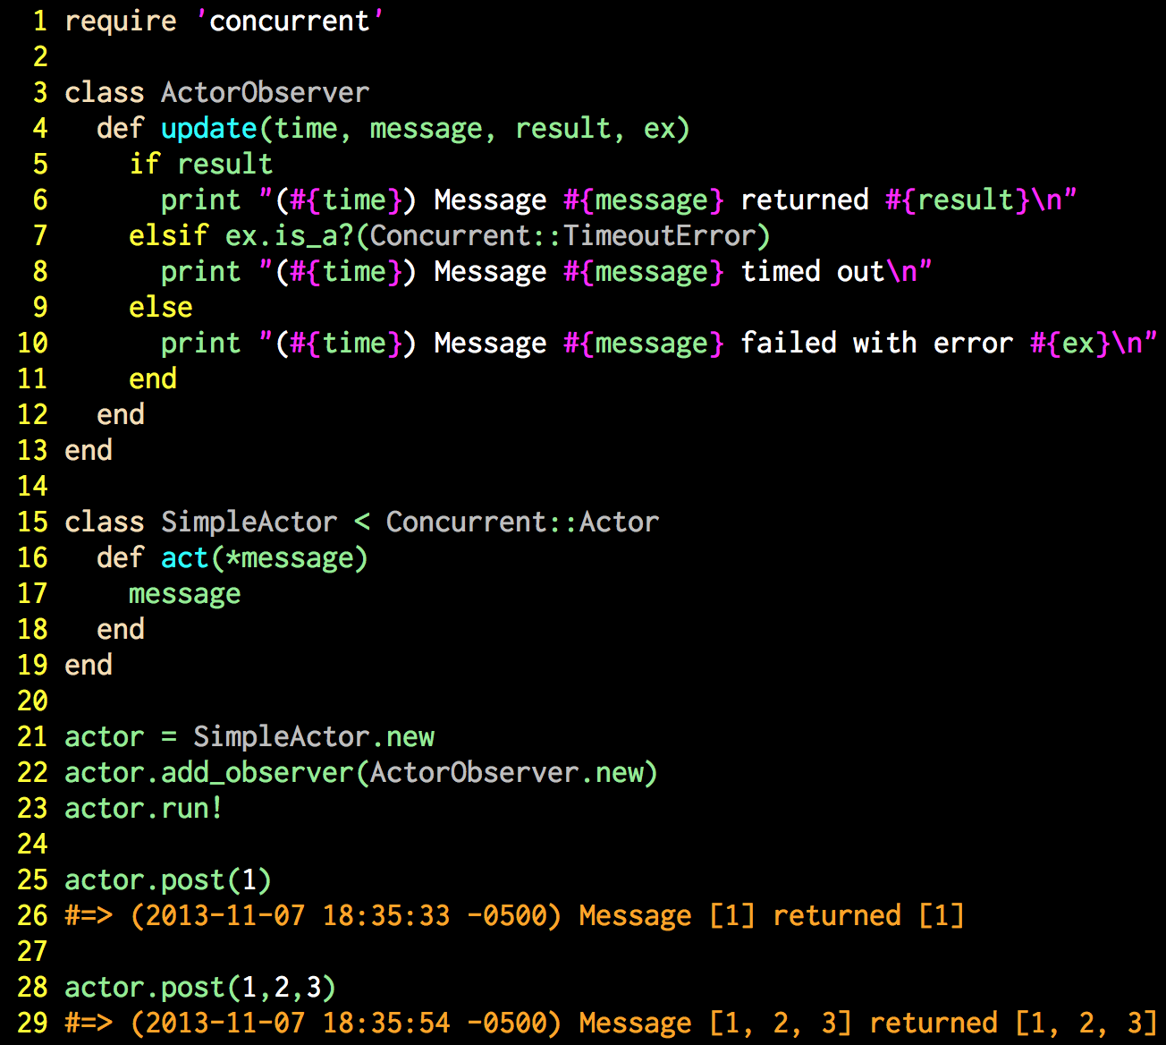
Notes:
## Slide 24: Actor with observation
* It should be no surprise by this time that `Actor` includes the `Observable` mixin
module and can be observed in standard fashion
* Note that the observer's `#update` method also receives the message as an argument

Slide 25
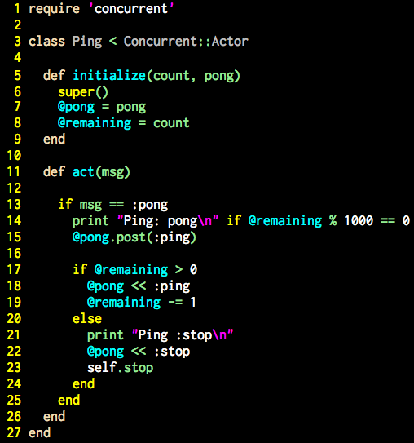
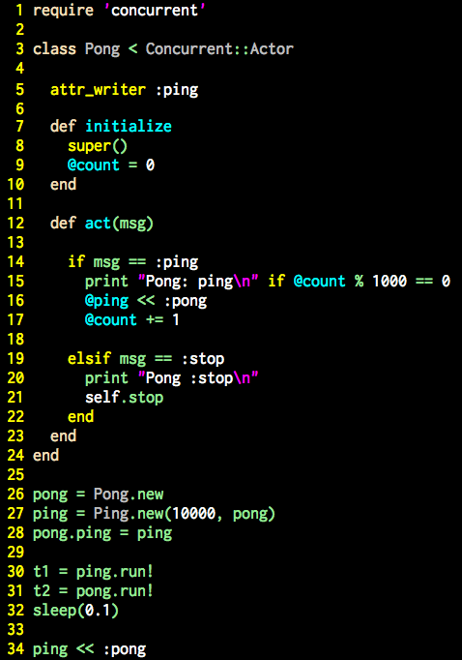
Notes:
## Slide 25: Actor Ping Pong
* The canonical actor example seems to be two actors playing ping pong
* This is a Ruby variant of a Scala version implemented in a well-known tutorial
* http://www.scala-lang.org/old/node/242

Slide 26
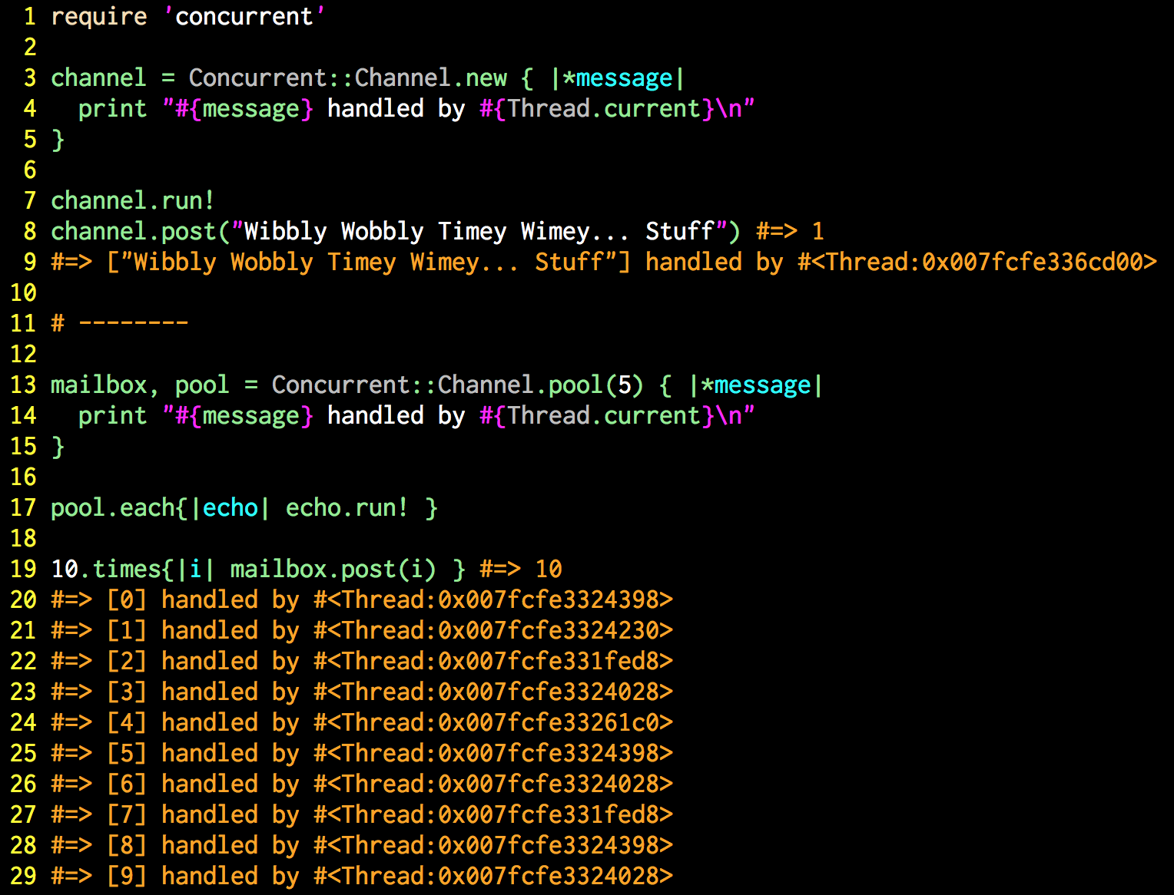
Notes:
## Slide 26: Don't change the channel!
`Channel` is a functional programming variation of `Actor`, based very loosely on the [MailboxProcessor](http://blogs.msdn.com/b/dsyme/archive/2010/02/15/async-and-parallel-design-patterns-in-f-part-3-agents.aspx) agent in [F#](http://msdn.microsoft.com/en-us/library/ee370357.aspx). The `Actor` is used to create objects that receive messages from other threads then processes those messages based on the behavior of the class. `Channel` creates objects that receive messages and processe them using the block given at construction. `Channel` is implemented as a subclass of [Actor](https://github.com/jdantonio/concurrent-ruby/blob/master/md/actor.md) and supports all message-passing methods of that class. `Channel` also supports pools with a shared mailbox.
See the [Actor](https://github.com/jdantonio/concurrent-ruby/blob/master/md/actor.md) documentation for more detail.

Slide 27

Notes:
## Slide 26: Who watches the Watchmen?
* Erlang is known for its fault tolerance, known to be helped achieve nine-nines of uptime (99.9999999%) in one well-known case (http://stackoverflow.com/questions/8426897/erlangs-99-9999999-nine-nines-reliability)
* The fault tolerance has less to do with the language and the virtual machine than it does deliberate design decisions
* One key tool for obtaining high uptime is the Supervisor module
* http://www.erlang.org/doc/man/supervisor.html

Slide 28
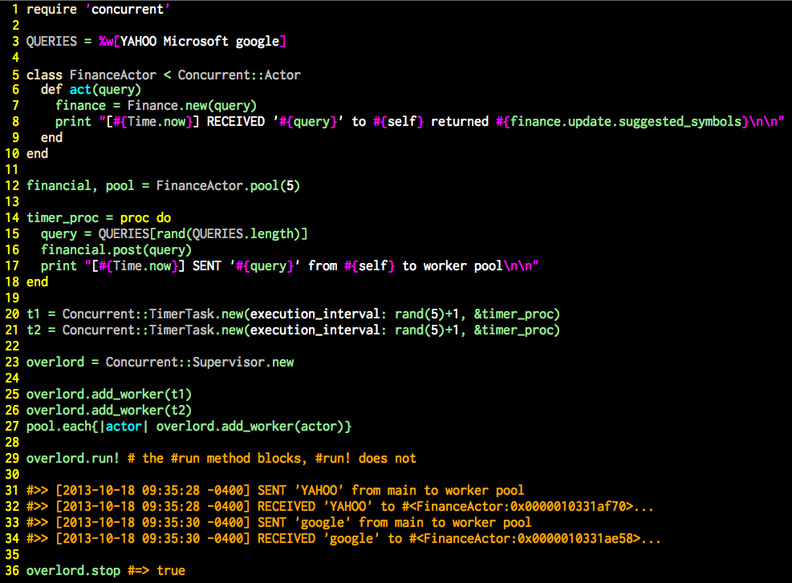
Notes:
## Slide 27: The awesome power of the Supervisor
This complex example combines actors, actor pools, timer tasks, and supervisors to show the power of the Concurrent Library
* The supervisor class in the Concurrent Ruby library is a functionally-complete copy of Erlang's supervisor in Ruby
* Can be used with any object that supports three methods: a blocking `#run` method, a `#running?` predicate method, and a `#stop` method that can be called from a different thread
* The `Runnable` mixin module in this library provides that functionality
* Simple add one or more workers to the Supervisor and it will manage the lifecycle of the workers, including restarting them on failure
* Supervisors can supervise other supervisors, creating supervisor trees, just like Erlang (http://www.erlang.org/documentation/doc-4.9.1/doc/design_principles/sup_princ.html)
### Code example
* Create a simple actor for obtaining finance information
* Create a pool of actors
* A pool is a set of actors that share a common mailbox and load balance the processing of messages to the shared mailbox
* Create two timer tasks that send messages to the pool at random intervals
* Create a supervisor
* Add the actors and the timer tasks to the supervisor as workers
* Run the supervisor, which runs the workers
* See spot run...
* Stop everything by stopping the supervisor

Slide 29
Write Code!
github.com/jdantonio
@jerrydantonio
Notes:
## Slide 38: Write Code!
*This is my challenge to you: go write concurrent code!*
* Concurrency is hard
* Concurrent code behaves differently
* Concurrency requires different ways of thinking
* Concurrency uses different designs
*The only way to learn concurrency is to write concurrent code.*
* This presentation has shown many powerful things without ever showing `Thread.new`
* None of the code examples show more than 30 lines of code
* Most are less than 10 lines
* All of this code was tested in IRB (that's how the output was verified)
* This presentation and all the code is in GitHub and there is even a Gemfile
*Everyone here now has the ability to write concurrent code.*
* Open your favorite editor
* Open a console
* `git clone`
* `bundle install`
* `irb`
*Write Code*

